Slide 1

Web-based Ordering & Ingredient Estimating for Bakery Manufacturer
Project Proposal Presentation
Miss.Nontra Nonsee 542115026
Mr.Parinya Panyanak 542115034

Slide 2

AGENDA Introduction Problems System Review Technology Review Development Tools Review System Architecture System Workflows Limitation Quality Assurance Objectives Development Model Schedule & Milestone

Slide 3



The idea come from ?

Slide 4
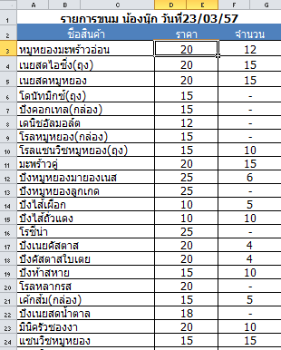

Phungnoi Workflows
Ordering stage

Slide 5

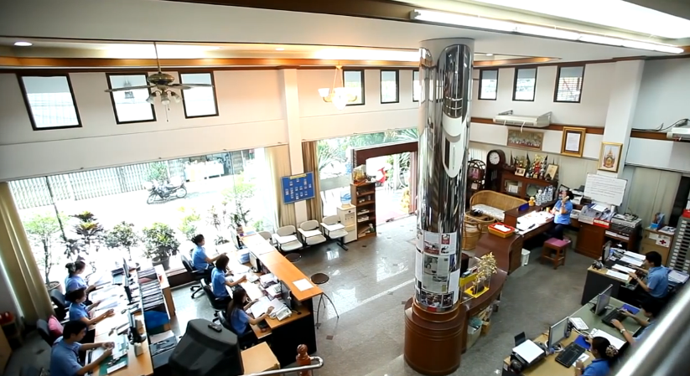
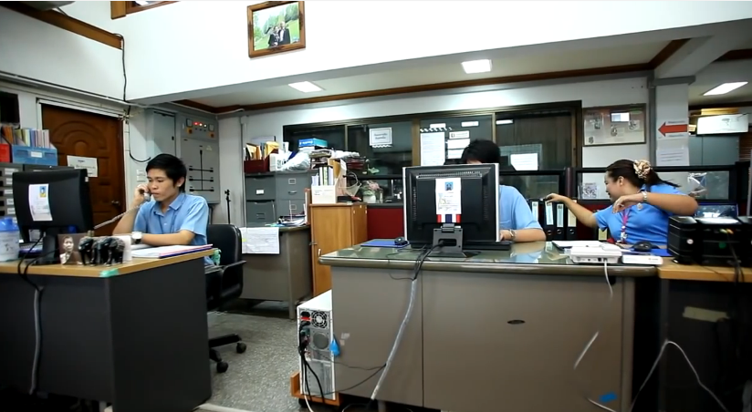
Phungnoi Workflows
Receiving stage

Slide 6
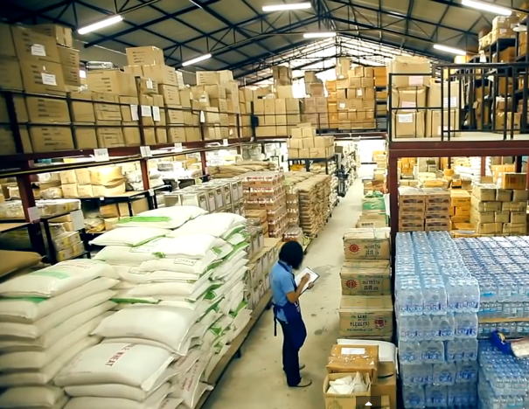
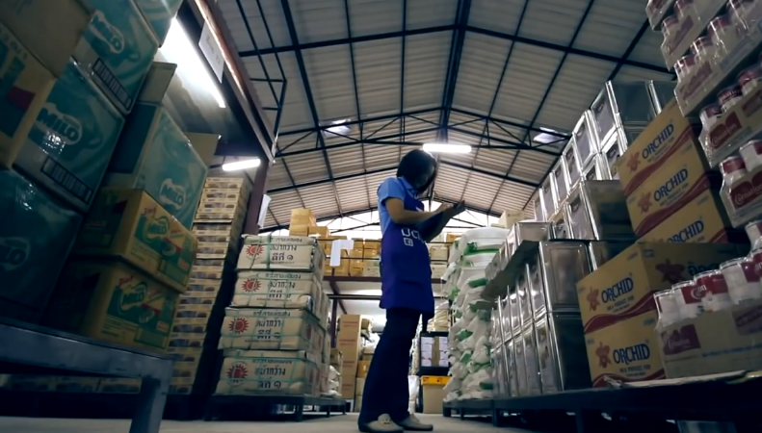
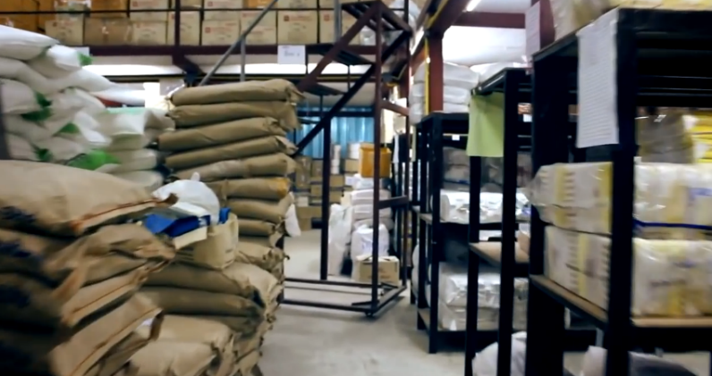
Phungnoi Workflows
Withdrawing stage

Slide 7

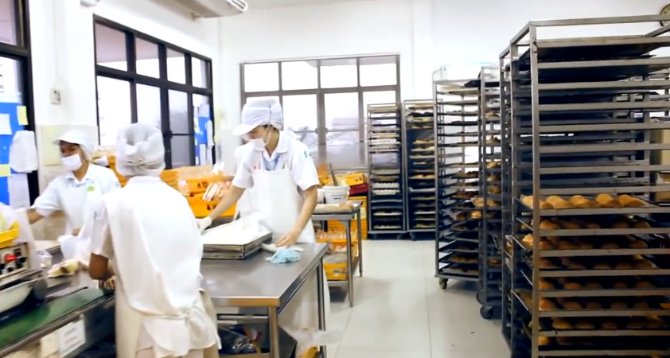

Phungnoi Workflows
Manufacturing stage

Slide 8
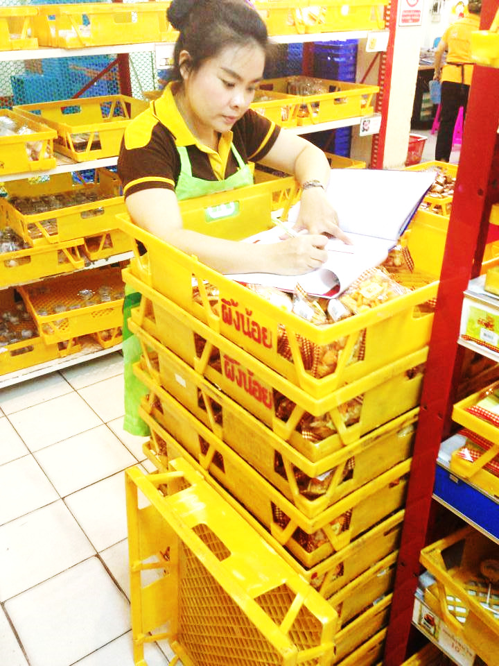
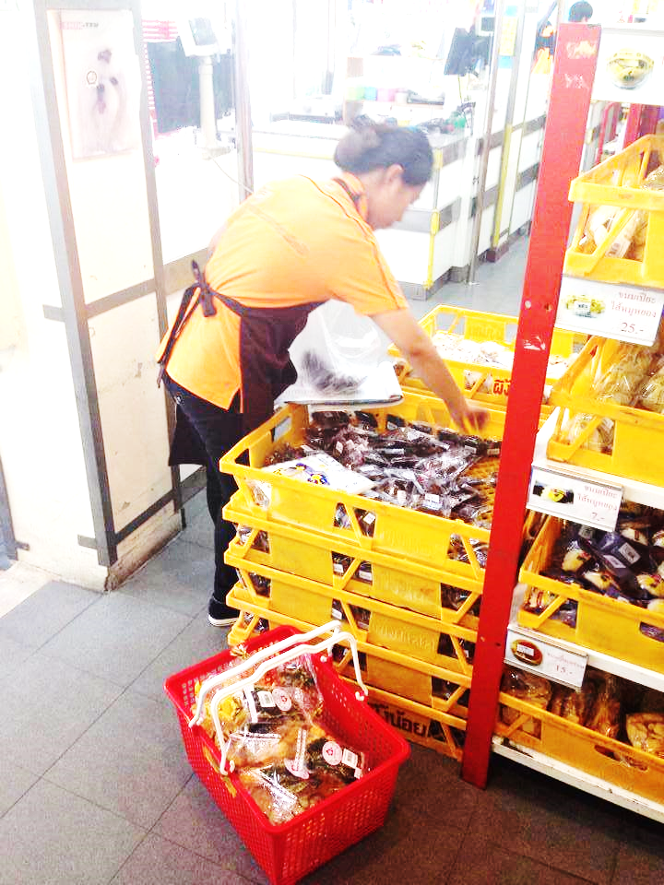
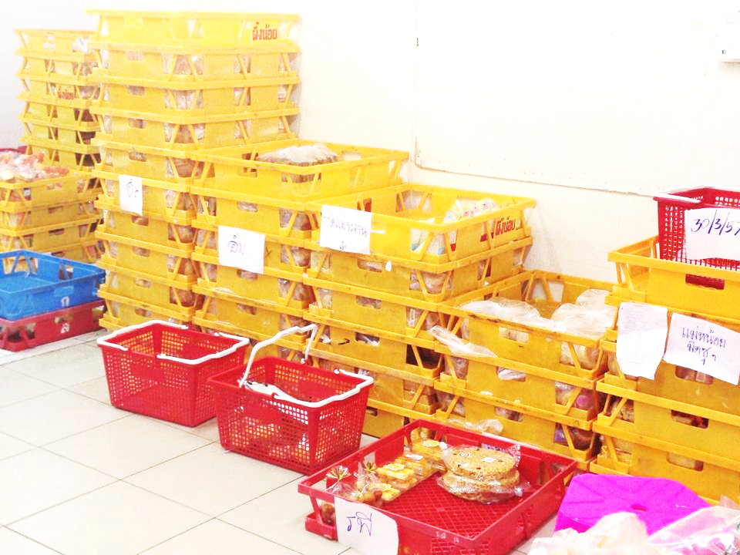
Phungnoi Workflows
Preparing stage

Slide 9


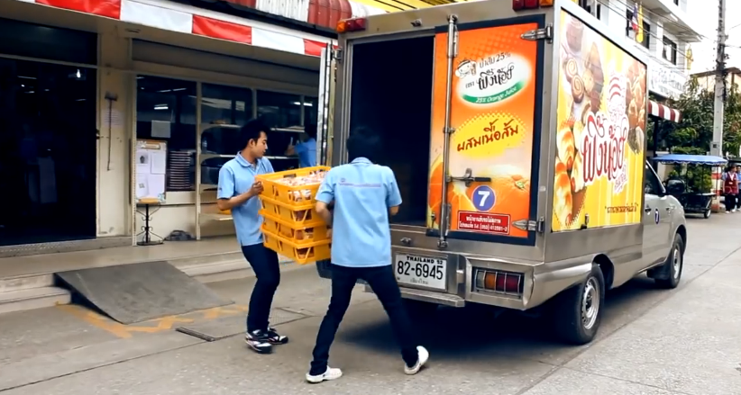
Phungnoi Workflows
Delivering stage

Slide 10
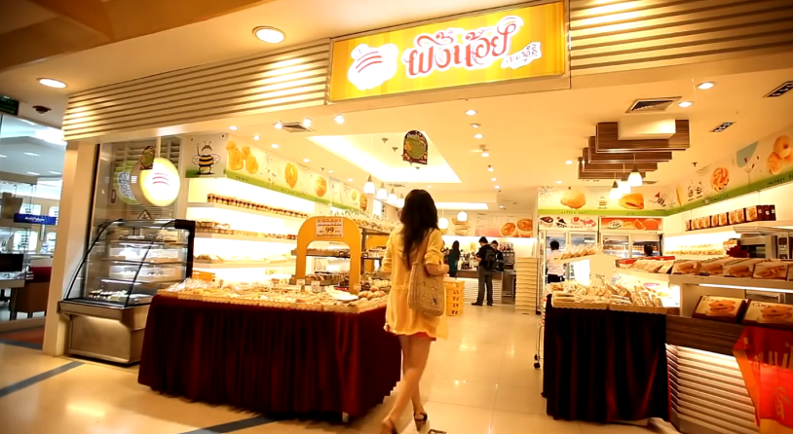

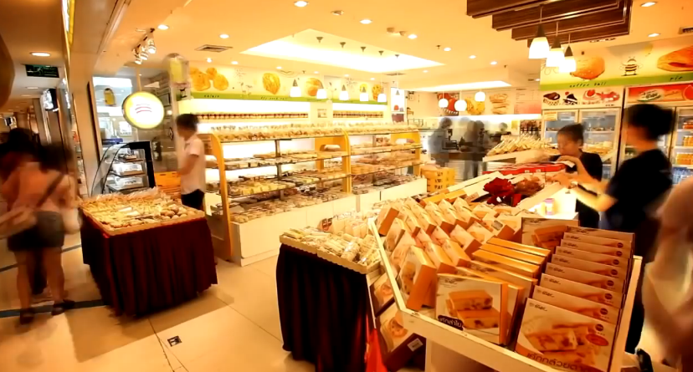
Phungnoi Workflows
Distributing stage
20 branches
37 wholesalers

Slide 11



Problems ?

Slide 12
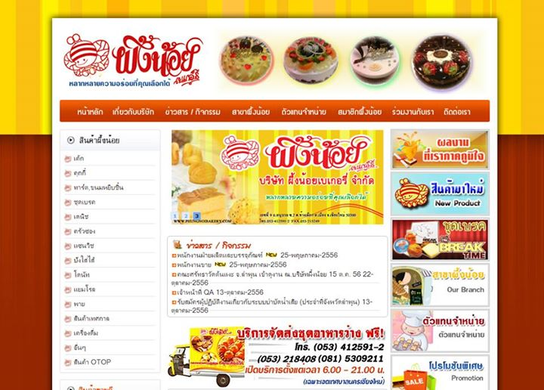


Ordering stage
Wholesaler

Slide 13

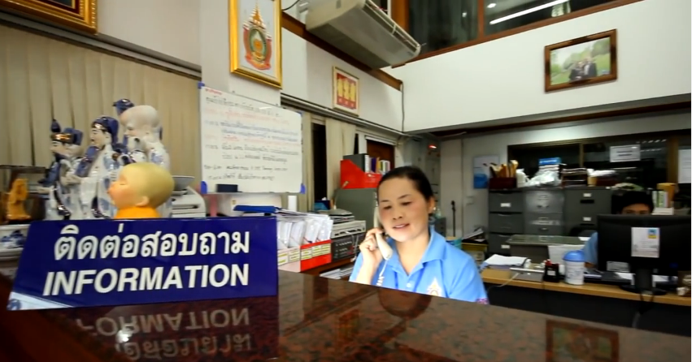


Receiving stage
Wholesaler A
Wholesaler B
Wholesaler C
Manufacturer

Slide 14




Withdrawing stage

Slide 15



Manufacturing stage

Slide 16







Preparing stage
Order A
Order B
Manufacturer
Order C
Order D

Slide 17






Delivering stage
Wholesalers
Manufacture

Slide 18
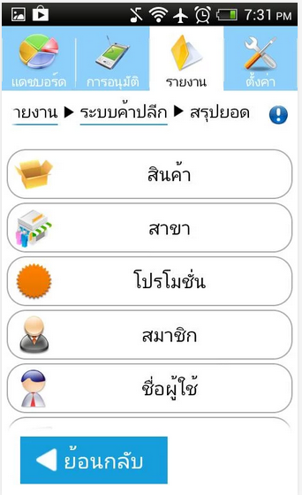
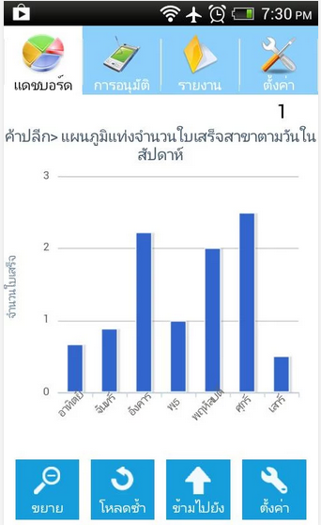
System Review
Absolute |Solutions| Website
Pros
Data are security from virus
Save investment
Support every operation system
Support alert message with SMS and email
Cons
Support only staff side
No estimate budget planning
No summary report

Slide 19
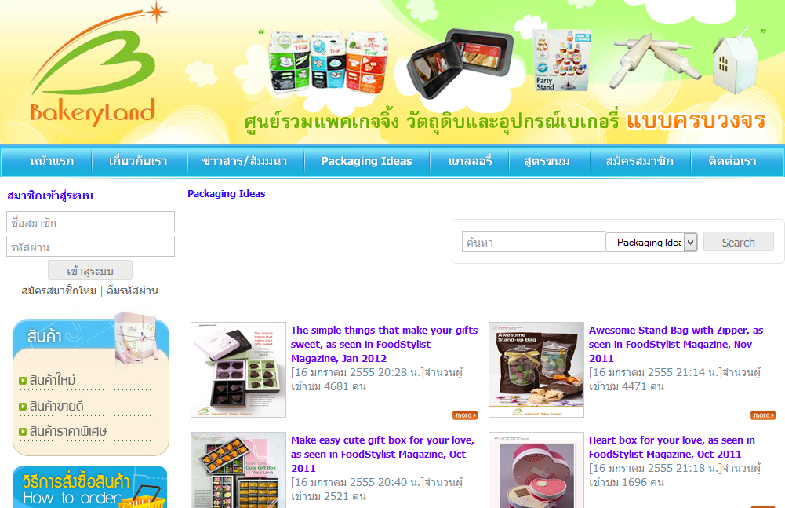
System Review
Bakeryland Website
Pros
Order the product online
Have tutorial description for ordering
Easy designing for general user
Cons
Support only internet access area
Not covers all services for the factory side
Only customer can use the website

Slide 20
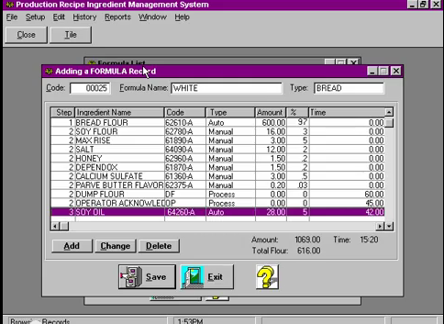
System Review
PRIMS Software
Pros
Easy for no experience user
Flexible technology to control the manual operation
Record each step in the process
Fast and accuracy
Cons
No automated information to the calculate process
No summary statistical data become to a graph
Not covers all report type

Slide 21




รายการทางบัญชีสำคัญที่ ต้องพิจารณา ในการวิเคราะห์งบการเงิน
Technology Review

Slide 22


รายการทางบัญชีสำคัญที่ ต้องพิจารณา ในการวิเคราะห์งบการเงิน
Development Tools Review

Slide 23
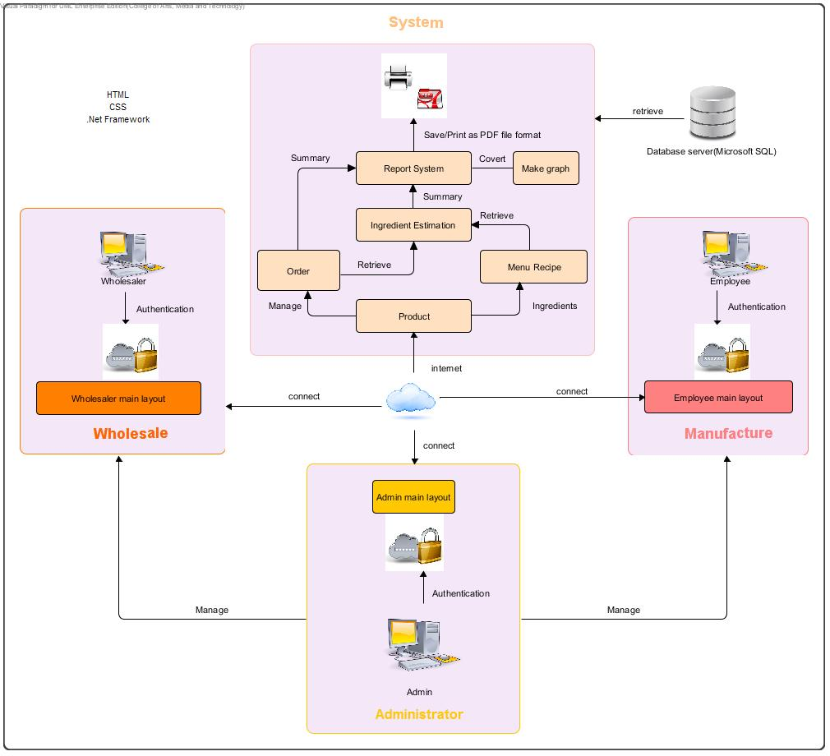

System Architecture

Slide 24







System Workflows
Return
Create
Menu recipe
Create
Order status
Create
Report
Product
Estimate
Order
Ingredient
Create
Graph
Management before 12.00
Create
Manufacture
Statistic
Wholesale
Purchase order
Return
Return

Slide 25


Limitation
Require Internet connection
Support only Phungnoi bakery workflows
Cannot integrate with existing software
Not support stock & billing system

Slide 26
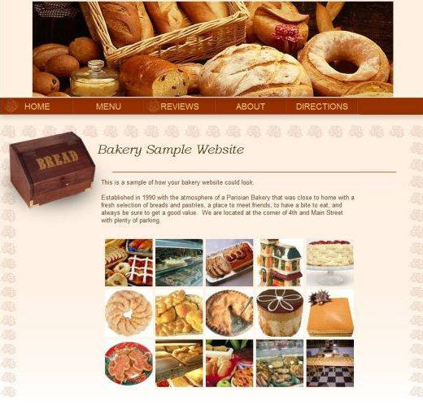

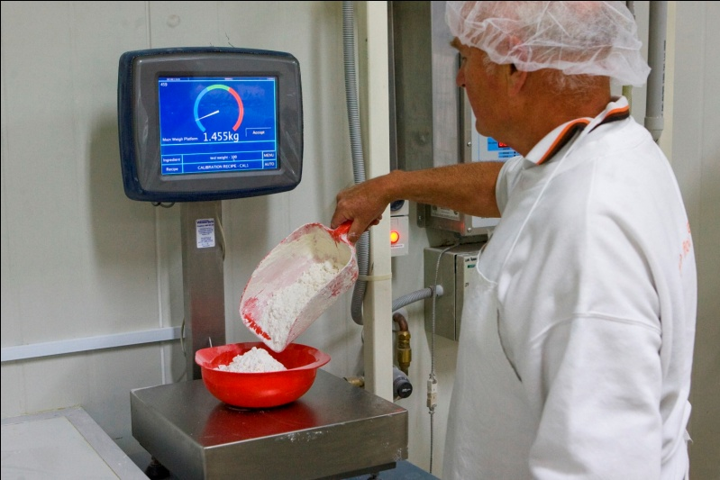
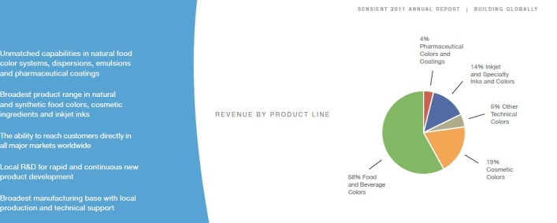
Objectives
Wholesaler ordering conveniently
Support Manufacture co-operation
Control ingredient usage & standard
Users has a summary report

Slide 27
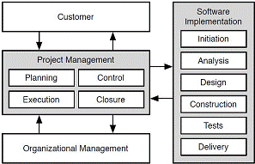
Quality & Assuarance
ISO 29110 – for Very Small Entity (VSE)

Slide 28
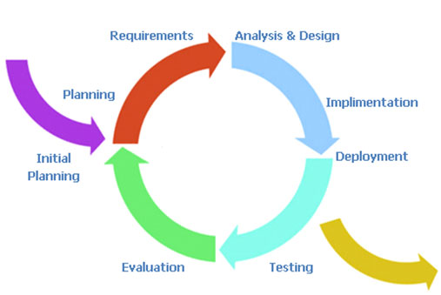
Development Process
Iterative Software Development Process
Develop a system through repeated cycles

Slide 29
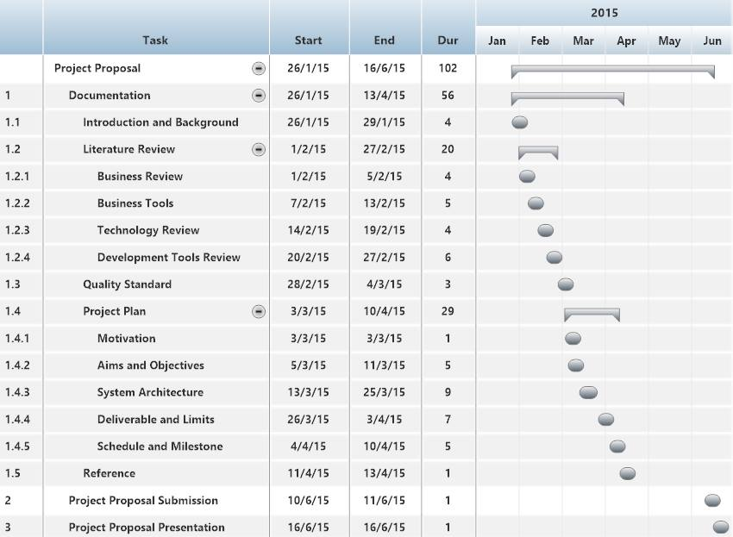
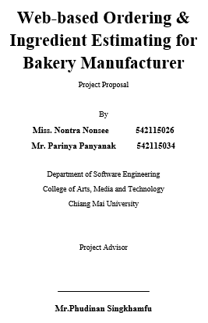
Schedule & Milestone
Proposal

Slide 30
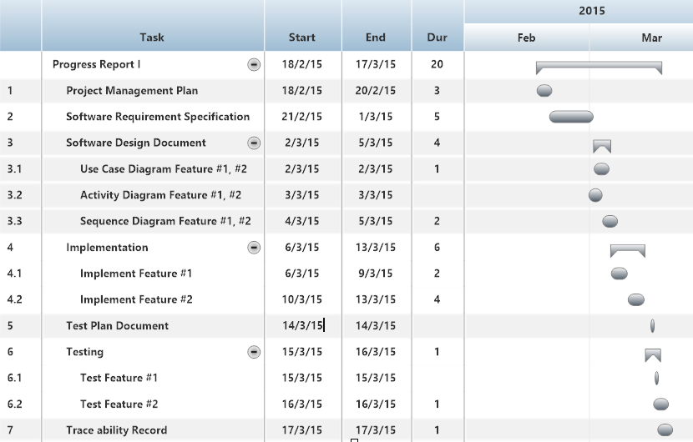
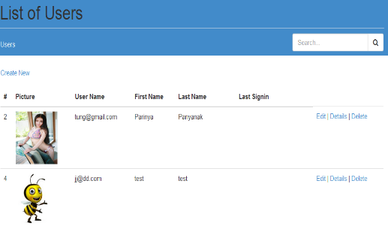
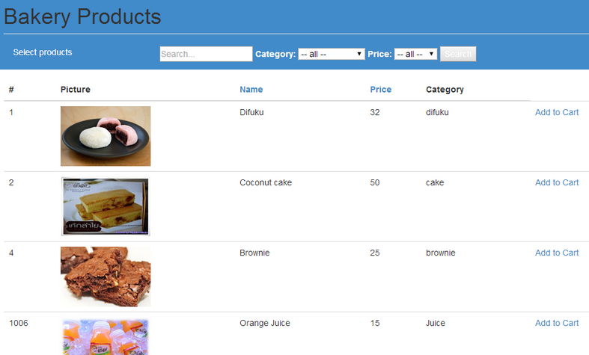
Schedule & Milestone
Progress Report I

Slide 31
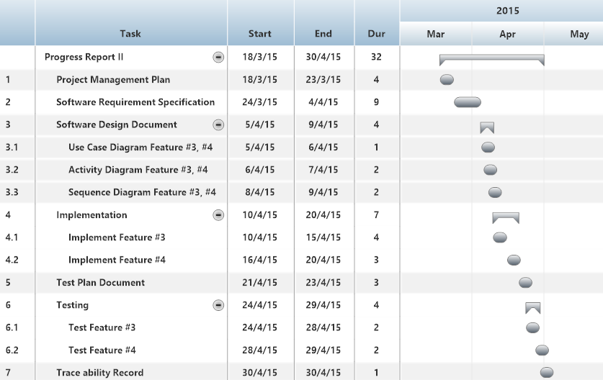
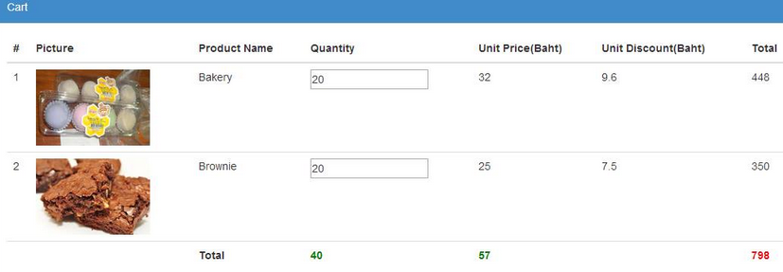
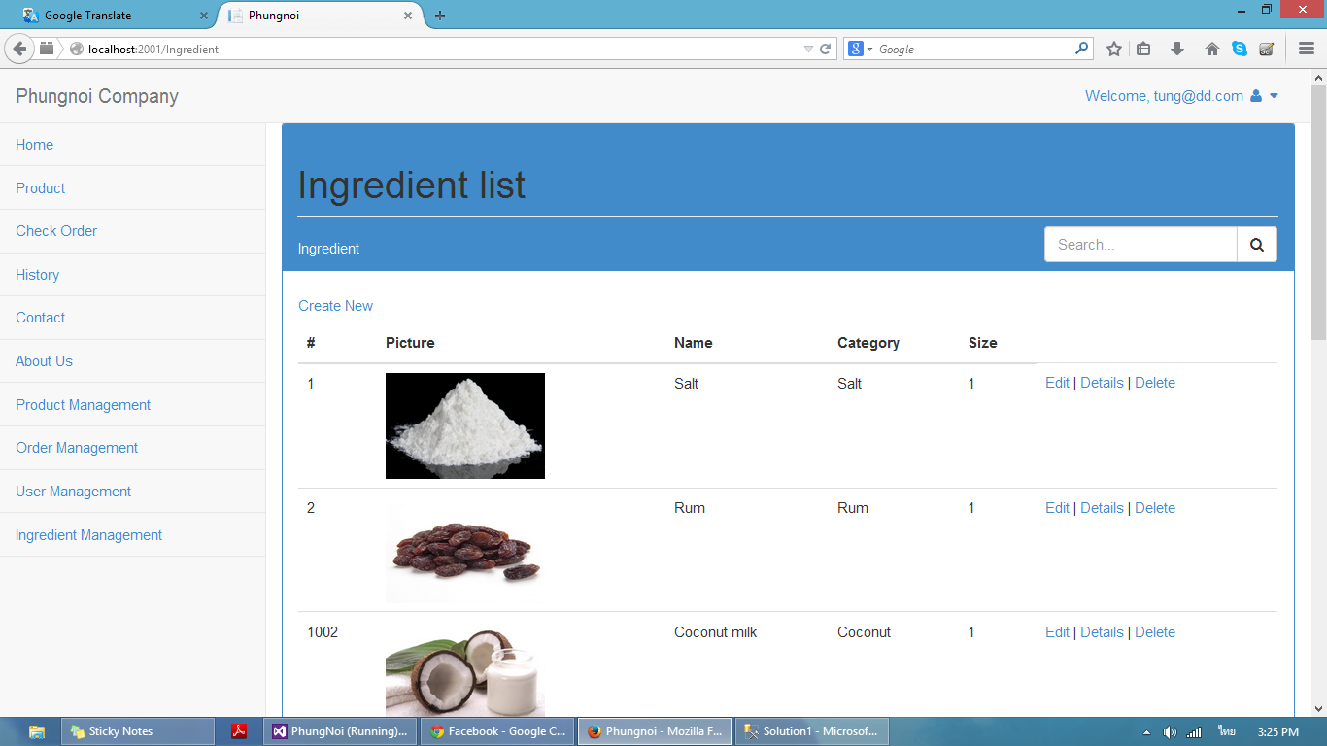
Schedule & Milestone
Progress Report II

Slide 32
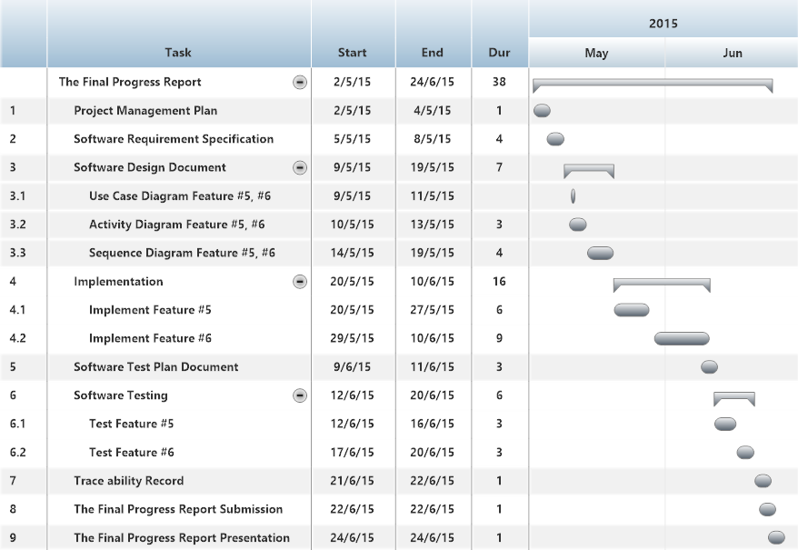
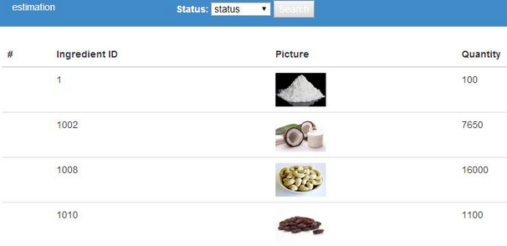
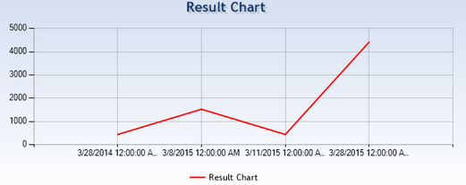
Schedule & Milestone
Final Progress Report

Slide 33
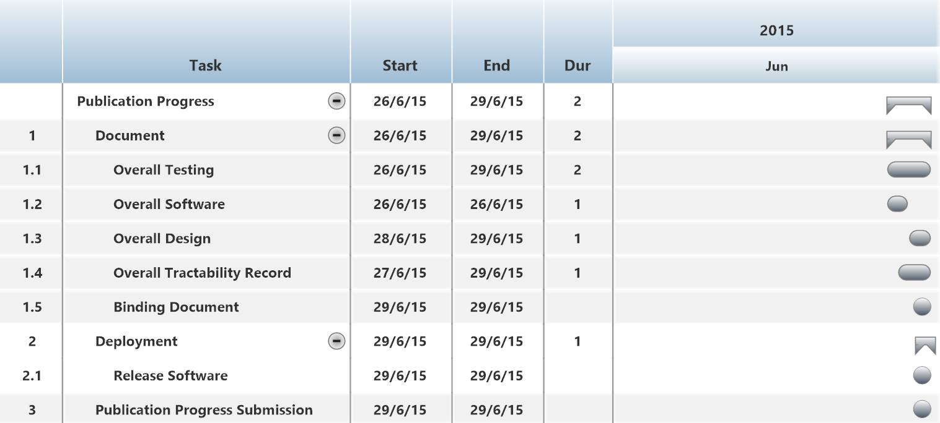
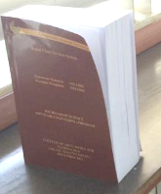
Schedule & Milestone
Publication Progress

Slide 34





THANK YOU
FOR YOUR ATTENTION

Slide 35

QUESTION & ANSWER

